Slide 1

“Strax” — Advancements in Topic Modeling
Technische Universität München
Fakultät für Informatik
NLP Lab Course, SS22
14.07.2022
Berk Sudan, Ferdinand Kapl, Yuyin Lang

Slide 2
Overview
LDA-BERT
Visualization
Yahoo Dataset & Visualizer
Current Status
‹#›

Slide 3
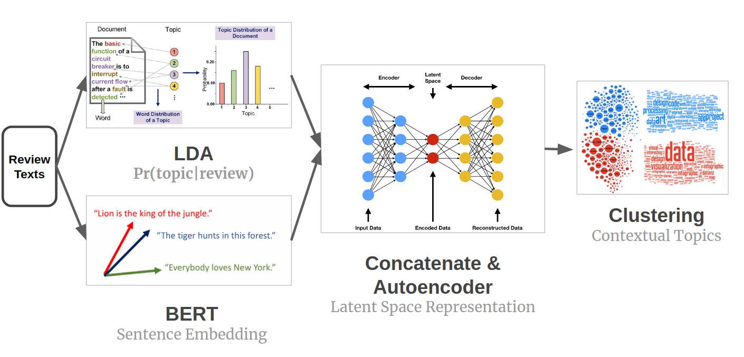
LDA-BERT
source: https://blog.insightdatascience.com/contextual-topic-identification-4291d256a032
‹#›

Slide 4
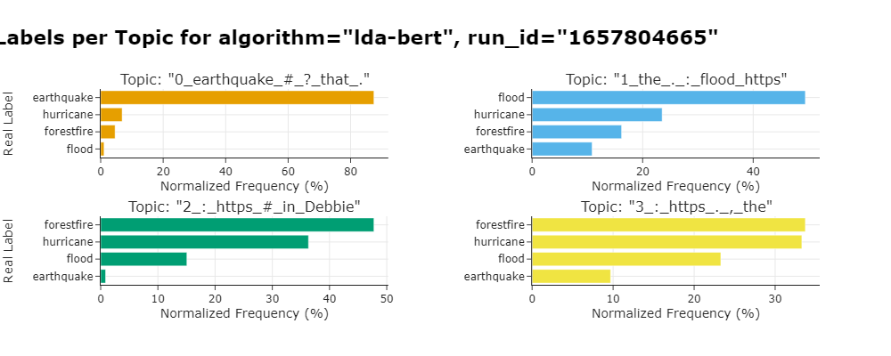
LDA-BERT: Current Results
‹#›

Slide 5
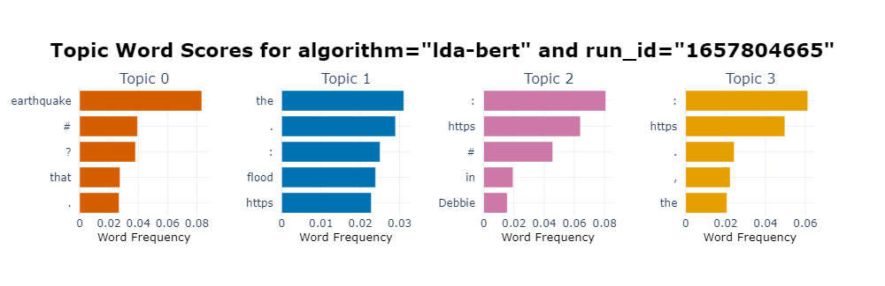
LDA-BERT: Current Results
‹#›

Slide 6
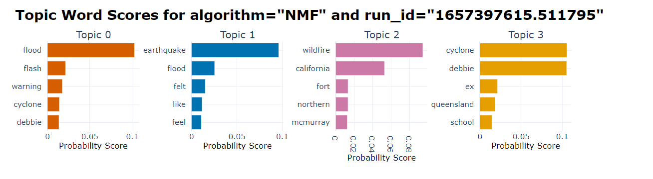
Visualization of LDA and NMF
‹#›

Slide 7
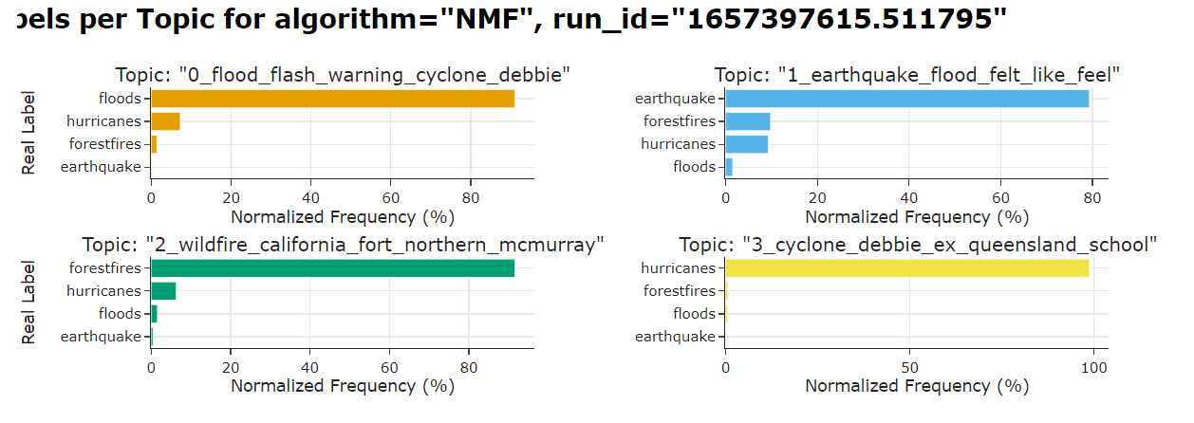
Visualization of LDA and NMF
‹#›

Slide 8
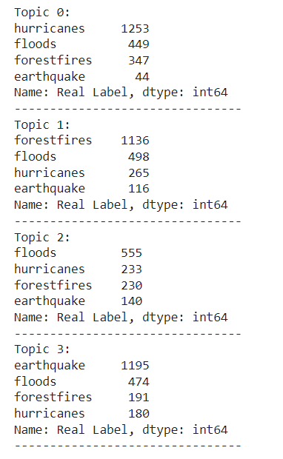
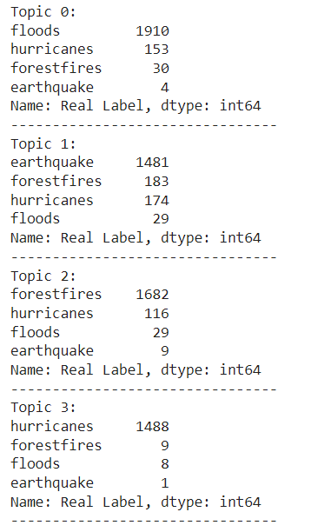
Visualization of LDA and NMF (for comparison)
LDA:
NMF:
‹#›

Slide 9
Glance at optional algorithms
Algorithms | Special for | Code availability
LSA | - | Basic code
PLSA | - | Basic code in Enstop
BTM | Short text | No python
DMM (GSDMM) | Short text | Basic code
WNTM | Short text | No python
CTM | - | OCTIS, need to read source code for more information
‹#›

Slide 10
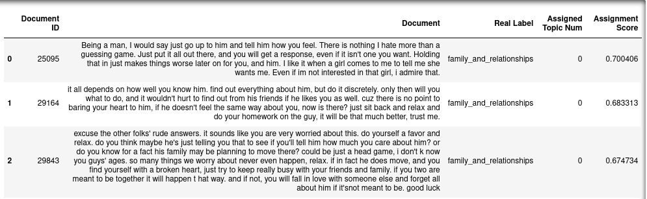
Yahoo Dataset - Characteristics
A Long Text Dataset
# of Classes: 10
# of Instances: 60K (selected randomly 300K+)
Instance / (Real Label): 6K
Excerpt from the data:
‹#›

Slide 11
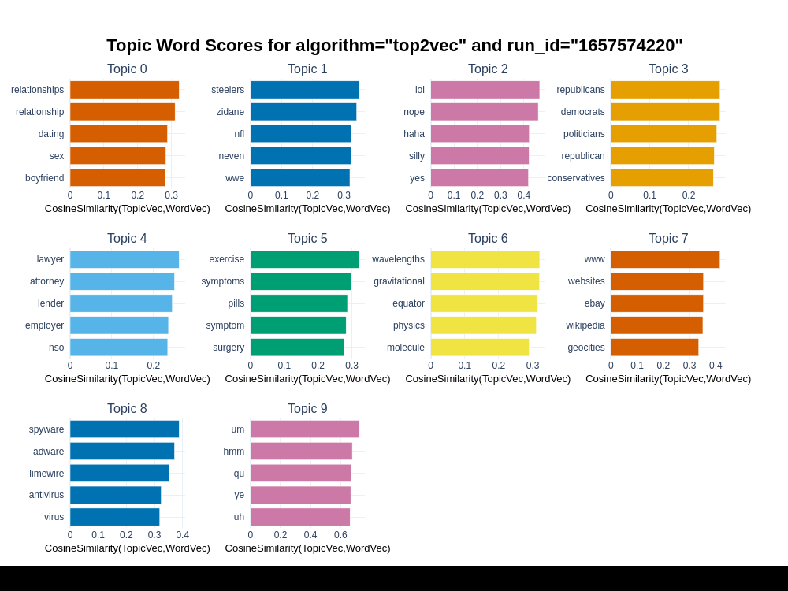
Yahoo Dataset - Topic Word Scores
‹#›

Slide 12
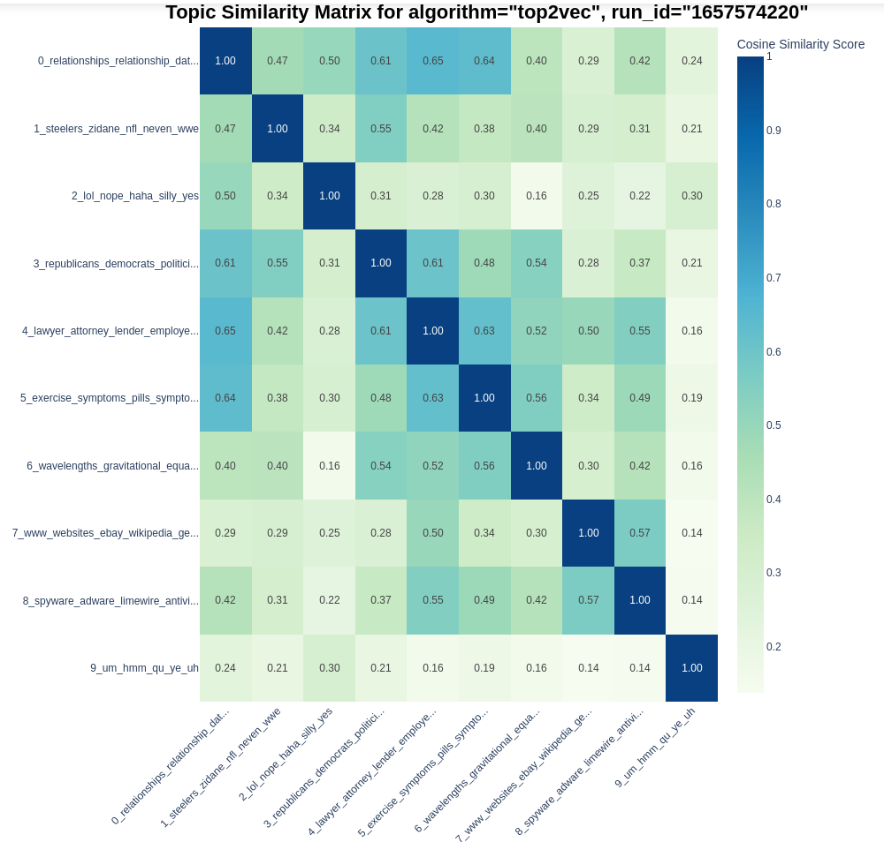
Yahoo Dataset - Topic Similarity Matrix (New)
‹#›

Slide 13
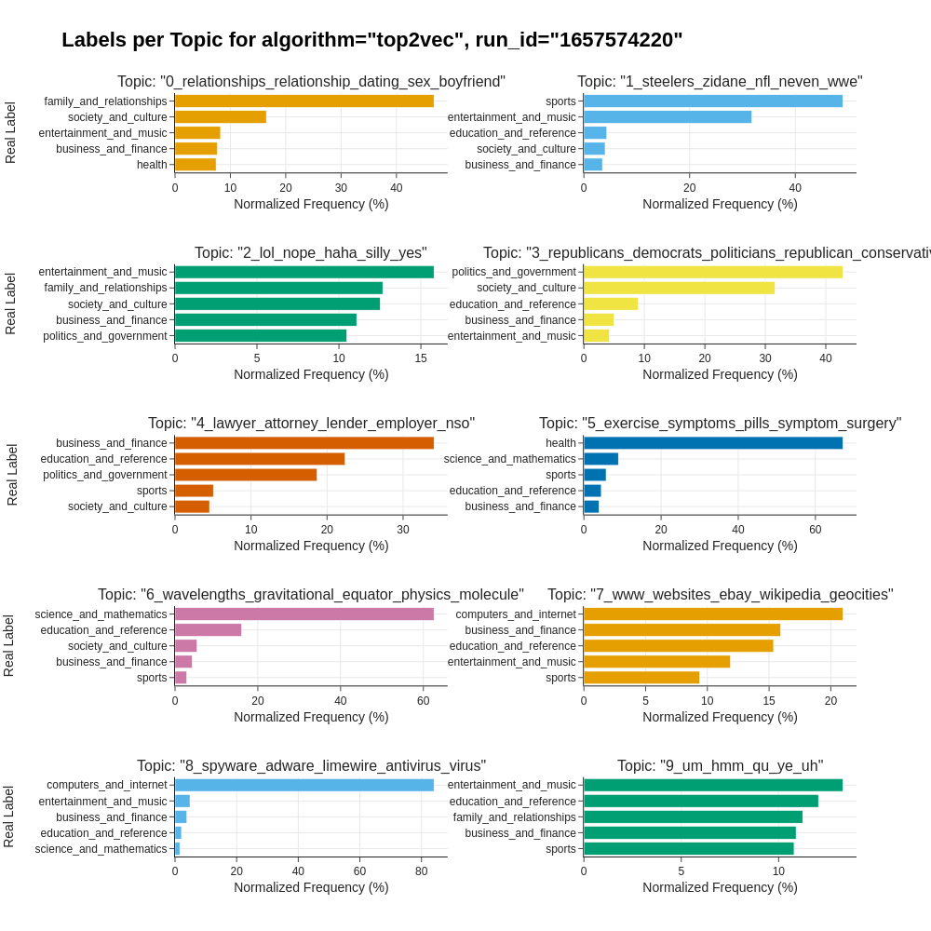
Yahoo Dataset - Labels per Topic (New)
‹#›

Slide 14
Current Status & Next
DONE:
ALGs: LDA, NMF, Top2Vec, BERTopic, LDA-BERT
Visualizations: Topic words barcharts, Real label - Topic distribution, Umap embedding plots, Similarity Heatmap
NEXT:
Preprocessing
Evaluation Module:
Coherence Metrics: C_V Coherence & NPMI Coherence
Diversity Metrics: Unique Words Topic Diversity & Kullback-Liebler Divergence
Supervised Metrics: Rand Index
‹#›

Slide 15
Questions Time!!
‹#›

